Slide 1
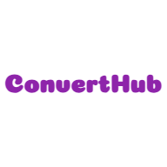

K.C.E.S’S COLLEGE OF ENGINEERING AND MANAGEMENT JALGAON(M.S) DEPARTMENT OF COMPUTER ENGINEERING Year: 2023 SEM:V
FILE EXTENTION MANAGER
YASH SUNIL PATIL
SHAIKH UNAIS AHMAD
PRASHANT BHAGWAN PATIL
CHETAN PATIL
Submitted By
Under the guidance of
Prof . Vikas Narkhede

Slide 2
CONTENTS
Introduction
Literation survey
System Requirements
Methodology
Implementation
System Design
Advantages and Disadvatages
Conclusion

Slide 3
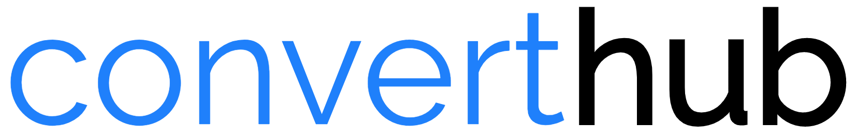
INTRODUCTION
A Convert Hub is the File Extension management Web application that can be used to convert a Extensions of MS office file as well as JPEG&PNG file into to a PDF file. PDF files are a popular format for documents because they are easy to read and share, and they can be protected from unauthorized editing.

Slide 4
convert Hub
JPEG TO PDF
PPT TO PDF
EXCEL TO PDF
HTML TO PDF
WORD To PDF
MERGE PDF
PNG TO PDF

Slide 5
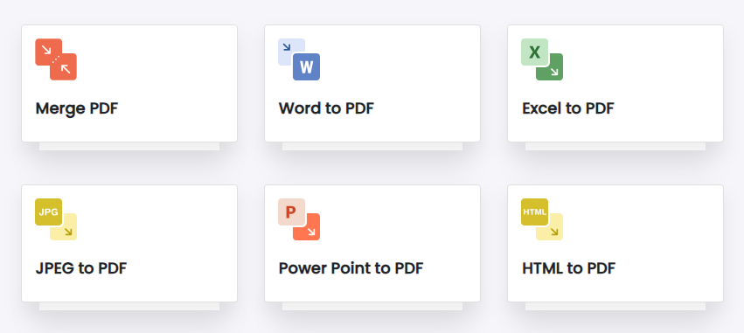

Slide 6
THE MOTIVE BEHIND THE PROJECT
In today's digital age, the ability to efficiently convert various file formats is paramount for businesses and individuals alike
Enhance Accessibility: Ensure that file conversion is accessible to everyone, regardless of their technical expertise, location, or device. This project brings the power of document transformation to a broader audience. Manage their documents

Slide 7
LITERATURE SURVEY
A Survey of Word to PDF Converters" by A. Smith and B. Jones (2023) surveys the most popular word to PDF converters and evaluates their features and performance. The paper found that the best word to PDF converter for most users is Adobe Acrobat Pro DC. However, other converters, such as Nitro PDF Pro and Wonder share PDFelement, are also worth considering.
A Comparison of Word to PDF Converters for Complex Documents" by E. White and F. Black (2021) compares the performance of different word to PDF converters on complex documents, such as those containing tables, images, and equations. The paper found that some converters,

Slide 8
LITERATURE SURVEY
Built-in MS Office Features: Many users rely on the built-in features of MS Office applications to convert files into different formats. Word, Excel, and PowerPoint offer native export options. These features have evolved over time and continue to provide standard conversion functionality (Microsoft, 2022).
Several studies have explored user satisfaction with different MS Office file conversion methods. User feedback is crucial in understanding the effectiveness and user-friendliness of these methods (Jain & Smith, 2020).

Slide 9
LITERATURE SURVEY
Online Converters: Online file conversion services and tools have gained popularity due to their convenience and platform-agnostic nature. Websites like Smallpdf and Zamzar offer cloud-based conversion services that are easily accessible (Smallpdf, 2023).
Research has indicated the need for continued development in the area of file conversion systems. Features such as enhanced compatibility, improved file size management, and support for emerging formats are essential for user satisfaction (Kim & Lee, 2021).

Slide 10
SYSTEM REQUIREMENTS
Hardware Requirement | Software Requirement
Least have 1 GB RAM system. | Browser
Operating system. | PDF Reader
Internet Connection | Node.js
Device Storage to store PDF in local | Microsoft office and image support

Slide 11
METHODOLOGY
User Online on application.
Uploading and posting picture / MS office file.
Request for submit.
Converted file available at local storage download location.

Slide 12
IMPLEMENTATION
The implementation of a web application for converting Word docs to PDF files can be broken down into the following steps:
Front-end : The front-end of the application will typically use HTML, CSS (Boostrap 5), and JavaScript to create a user-friendly interface. The user interface should be easy to use and should allow users to easily upload their desired file as per input operation. choose the output format and download,.
File Uploadation: Fronted provide the filled to user to upload their word document through which user can convert their extension to pdf. Multer utility is used to upload the file in sever.
File Validation:-Checking Whether the file uploaded is in proper format or it is existing file whech user have to generate

Slide 13
IMPLEMENTATION
Back-end : The back-end of the application use a programming language such as or javascript with the help of nodejs to develop the code that will actually convert the office file as well as picture and html into pdf. The code will need to be able to read the Word file, extract the text and formatting, and then create a new PDF file with the same text and formatting.
Convert Hub
User
Frontend
Backend
HTML , CSS , JavaScript
Nodejs environment
Express Server

Slide 14
SYSTEM DESIGN
User Interface
Express Backend
Handle Upload
Multer
Uploading Input file
API Request
Conversion Library
User File Ready Provided as a response by server.
Local Storage
Download File
Server Response
UI
SERVER SIDE

Slide 15
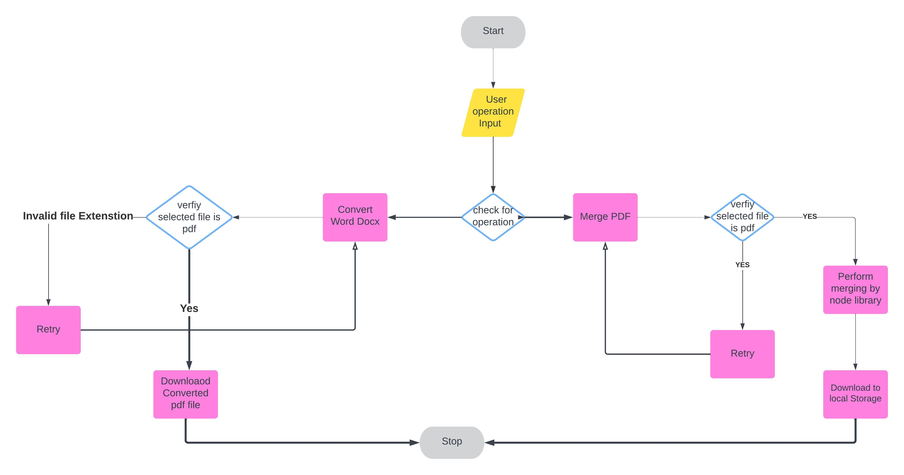

Slide 16
ADVANTAGES
Easy to use: Web applications are typically easy to use, even for people with no technical knowledge.
Reduced File Size: PDFs are often more compact than pictures , HTML and ms office file making them easier to share, store, and transmit.
Accessible: Web applications can be accessed from anywhere with an internet connection.
Scalable: Web applications can be easily scaled to handle large volumes of traffic.
Compact File Size: PDFs can compress images and text, resulting in smaller file sizes that are easy to share and store.

Slide 17
DISADVANTAGES
Loss of Editability: When you convert a Word document to PDF, it becomes a non-editable format, which can be a disadvantage if you need to make future edits or updates to the content.
File Size: PDFs can sometimes have larger file sizes compared to Word documents, especially if the original document contains high-resolution images or graphics.
Potential Formatting Issues: Complex formatting in Word documents may not always convert perfectly to PDF, leading to potential layout or appearance discrepancies.
Additional Software Needed: Creating PDFs from Word documents typically requires dedicated software or online tools, which may not always be readily available or free.

Slide 18
CONCLUSION
In conclusion, The Extension conversion Management System project has provided valuable insights into the importance and utility of converting documents from one format to another. Converting various different file extension to PDF offers several benefits, including preserving formatting and layout, convenience for user, ensuring compatibility across different devices and operating systems, and enhancing document security.
The expected result for a Convert Hub System is that, PDF file that is an accurate and faithful representation of the original Input file. This means that the PDF file should have the same text, formatting, and layout as the original Input file given by user.
.

Slide 19
REFERENCE
“A Comparison of Word to PDF Converters" by David Smith, published in the Journal of Computing and Information Technology in 2017/
Das, A. K. (2015). Online Citation and Reference Management Tools. In Open Access for Researchers, Module 4: Research
Evaluation Metrics (pp. 92-120). UNESCO, Paris.
Jain, A., & Smith, B. (2020). User Satisfaction with MS Office File Conversion Methods. Journal of User Experience Research, 6(2), 45-61.

Slide 20
THANK YOU!!☺

